Slide 1
Software Engineering and Architecture
Quality Attributes

Slide 2
Good or Bad?
When I was taught OO programming and design, there was often statements like
”This is not good OO design”
Which was more or less equal to the statement
  I do not like it…
Theological statement ☹

Slide 3
What does “good” mean?
Question: Is this little C program an example of good or bad software?
Exercise 1: Argue that this is a good program!
Exercise 2: Argue that this is a bad program !
int a[1817];main(z,p,q,r){for(p=80;q+p-80;p-=2*a[p])for(z=9;z--;)q=3&(r=time(0) +r*57)/7,q=q?q-1?q-2?1-p%79?-1:0:p%79-77?1:0:p<1659?79:0:p>158?-79:0,q?!a[p+q*2 ]?a[p+=a[p+=q]=q]=q:0:0;for(;q++-1817;)printf(q%79?"%c":"%c\n"," #"[!a[q-1]]);}

Slide 4
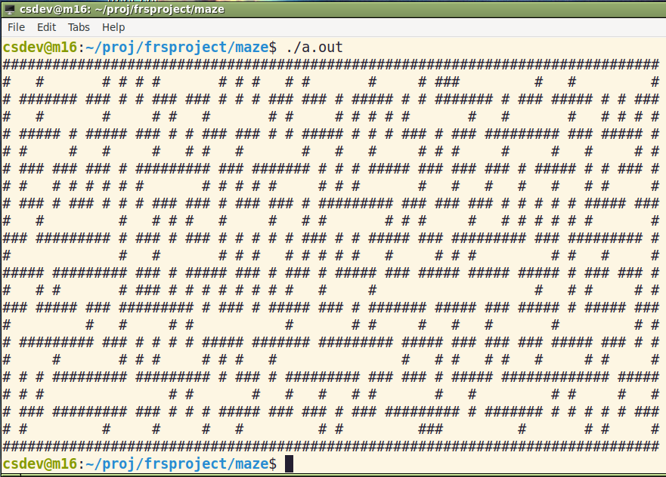
(What does the C program do?)
Process
  Paste string
  into file ‘m.c’
  Install ‘gcc’
  gcc m.c
  ./a.out
  Done…

Slide 5
The need for measuring
The server is highly available...
My software is really easy to read! Self-explanatory
Our high performance server will...
These are simply claims ☺
Actual measurements on well defined scale is better...

Slide 6
Quality Attributes
The problem about ”good” or ”bad” is that they are subjective measures...
We need to measure our software. This requires
  that we define the aspects/qualities we measure
  that we agree on some kind of scale: a metric
Quality attributes (da: kvalitets-attributter)

Slide 7
Measuring quality
Quality Framework
Quality Attribute
Performance
Metric
Usability
Measurement
Choose alternatives
Modifiability
Notes:
En metrik kan være kvalitativ: høj usability / lav usability; eller kvantitativ: en kassedame vil kunne benytte 80% af systemets funktionalitet efter 2 timers indlæring.

Slide 8
’Quality communities’
One aspects of qualities is that most of them have dedicated research communities associated:
  performance freaks (algorithm people, database, ...)
  usability freaks (HCI – human computer interface)
  security freaks
  cost freaks (managers ☺)
  reusability freaks (pattern community ☺)
...which has lead to lack of common vocabulary…
  user input, attack, event, failures, are all stimulus
We need to provide common ground

Slide 9
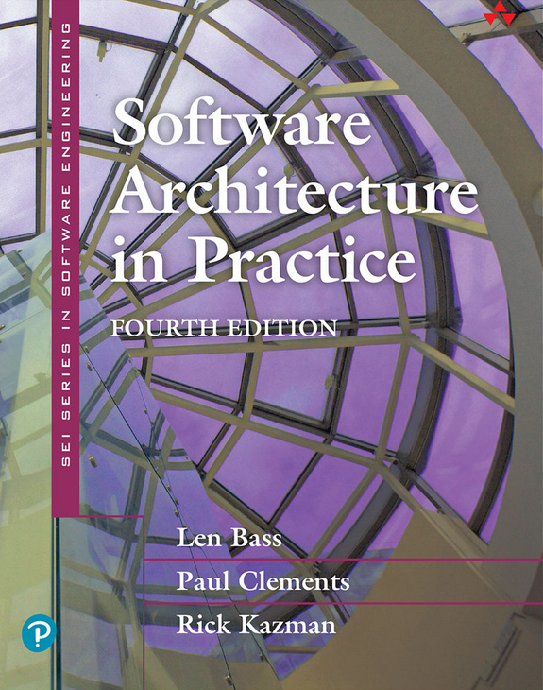
SAiP’s Contribution
The book Software Architecture in Practice has defined a conceptual framework that allow different architecturally qualities to be expressed in a similar form: A quality framework
Quality Attributes:
Set of qualities to consider
Quality Metric:
A technique for measuring them
Notes:
before the fact – that is QAS can be used in early architecture design phase – the napkin phase

Slide 10
Quality framework (Bass et al.)
System quality attributes
  Availability
  Modifiability
  Performance
  Security
  Testability
  Usability
  Integrability
  Deployability
  Energy Efficiency
  Safety
Business qualities
  Time to market
  Cost
  Projected lifetime
  Targeted market
  Roll-out schedule
  Integration with legacy sys.
Architectural qualities
  Conceptual integrity
  Correctness and completeness
  Buildability

Slide 11
The System Qualities
Availability
  Concerned with the probability that the system will be operational when needed
Modifiability
  Concerned with the ease with which the system supports change
Performance
  Concerned with how long it takes the system to respond when an event occurs

Slide 12
The System Qualities
Security
  Concerned with the systems ability to withstand attacks/threats
Testability
  Concerned with the ease with which the software can be made to demonstrate its faults
Usability
  Concerned with how easy it is for the user to accomplish a desired task and the kind of user support the system provides

Slide 13
The System Qualities
Deployability
  Concerned with the ease at which the system can be allocated to an environment for execution
Energy Efficiency
  Concerned with the energy required for the system to perform its tasks
Safety
  Concerned with the systems ability to avoid states that lead to damage, injury, or loss of life to actors in environment

Slide 14
Exercise
System quality attributes
  Availability
  Modifiability
  Performance
  Security
  Testability
  Usability
  Deployability
  Energy Efficiency
  Safety
Business qualities
  Time to market
  Cost
  Projected lifetime
  Targeted market
  Roll-out schedule
  Integration with legacy sys.
Which of these will have the greatest impact on your professional and personal lives?

Slide 15
“We want them all”
Qualities in conflict

Slide 16
The conflict of qualities
Many qualities are in direct conflict – they must be balanced !
  modifiability and performance
    many delegations costs in execution speed – and memory footprint
  cost and reusability
    highly flexible software costs time, effort, and money
  security and availability
    availability through redundancy – increase opportunities of attack
  modifiability and energy efficiency
    Simpler language like Python – increased
    energy cost
Java vrs Python
Same service;
2½ times more energy!

Slide 17
Design Patterns in Perspective
Examples of Good turning Bad

Slide 18

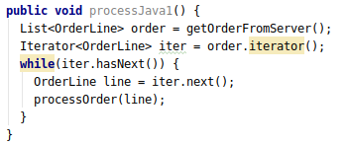
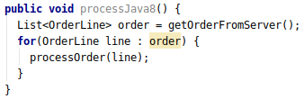
Iteration
In a distributed system, the clients need to iterate over all order lines in an order object...
Using Broker – the code looks exactly the same even when the Order and each OrderLine objects are on the server side !!! Great!
Iterator is a nice, flexible, design pattern ☺

Slide 19
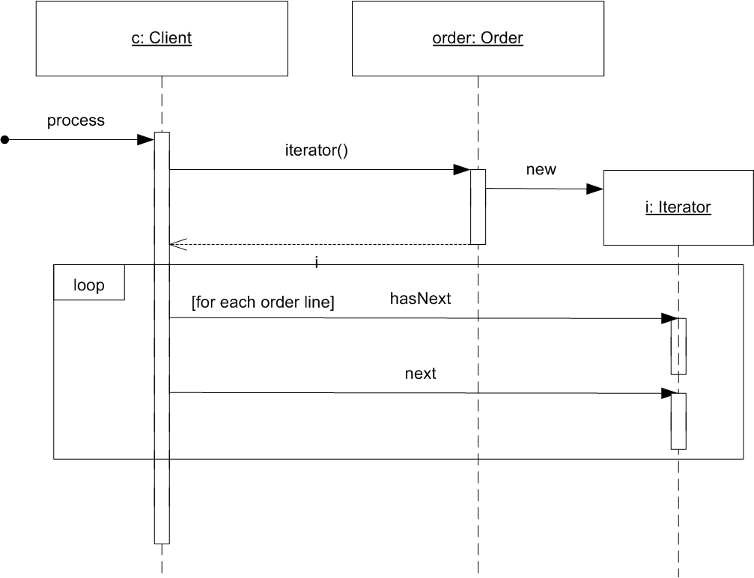
The sequence diagram
All is fine ...

Slide 20
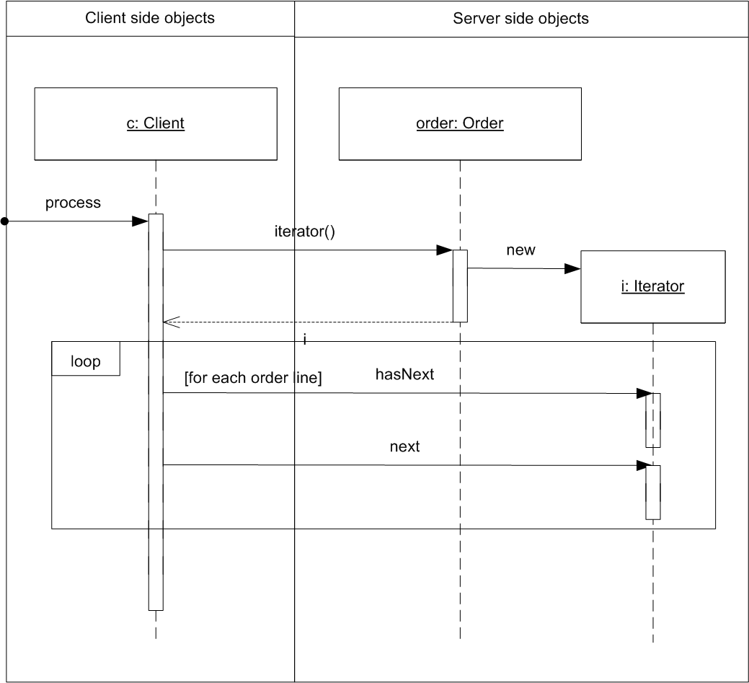
... but
Let us consider the deployment of objects
What’s wrong?

Slide 21
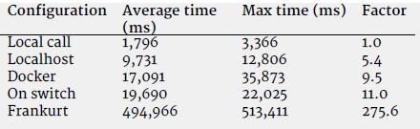
... what about performance ?
Message-call is really expensive over a network
  2018 data on TeleMed:
    Between a factor 11 to 275 times slow-down
      (depends on geography of the two machines)
The iterator pattern produces an extreme slow-down compared to transferring all order line objects in a single network package !
  Modifiability/maintainability high Performance low

Slide 22
Conclusion
We build software that has architectural quality attributes
  Availability Always working when I need it
  Modifiability Low cost to change or add features
  Performance Fast response time, no waiting for answer
  Security Authorized users only, no 3rd part
  Testability Easy to verify correctness by tests
  Usability Fast to learn, easy to use, productive
  Energy effiency Get most work done for least Watts
  …
We have to evaluate which are important in which contexts and then focus our efforts to achieve them in the best balance
  (Sometimes flexibility/patterns/frameworks are not the way to go!)

Slide 23

Evaluation!
Fill in the evaluation ☺
Start again at xx.xx

Slide 24
Quality Attribute Scenarios
Measuring QAs

Slide 25
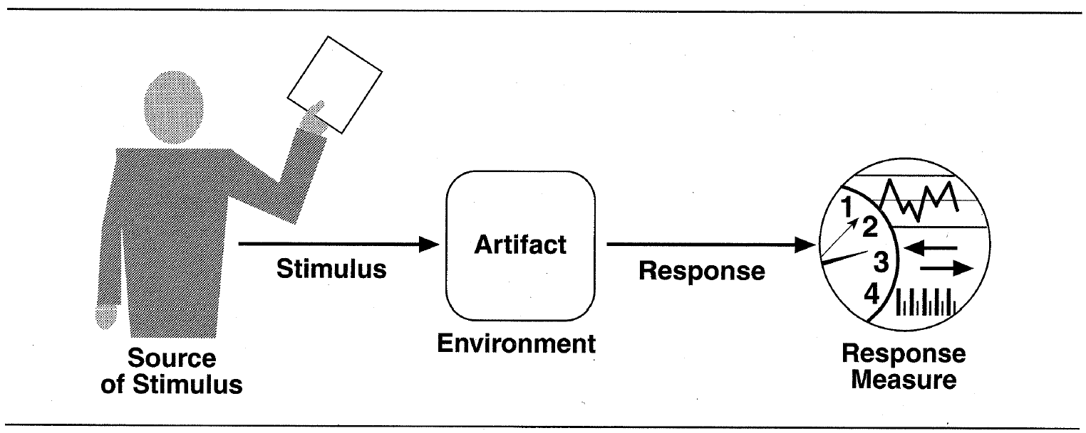
QaS: A Writing Template
Source of stimulus. This is some entity (a human, a computer system, or any other actuator) that generated the stimulus.
Stimulus. The stimulus is a condition that needs to be considered when it arrives at a system.
Environment. The stimulus occurs within certain conditions. The system may be in an overload condition or may be running when the stimulus occurs, or some other condition may be true.
Artifact. Some artifact is stimulated. This may be the whole system or some pieces of it.
Response. The response is the activity undertaken after the arrival of the stimulus.
Response measure. When the response occurs, it should be measurable in some fashion so that the requirement can be tested.

Slide 26
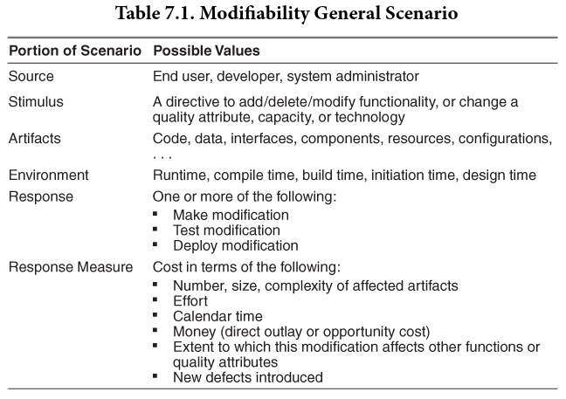
Modifiability
Concerned with the ease with which the system supports change
The central QA that
SWEA is all about!

Slide 27
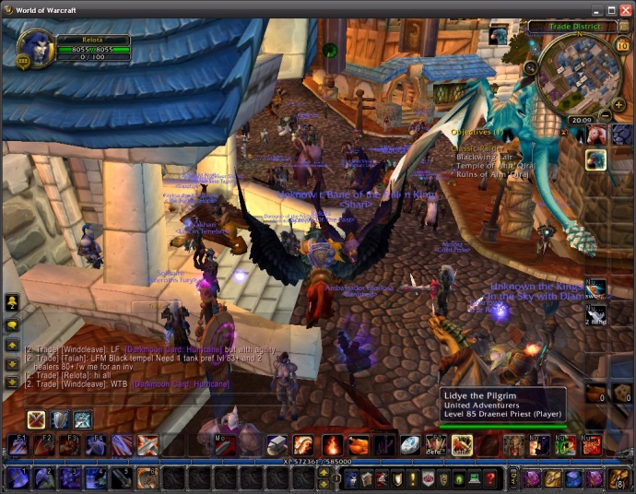
Exercise
”In WoW world design phase, it should be easy to change a landscape feature of the world”
How to formulate
it using a QAS
  Just how easy, is easy?

Slide 28
Exercise
A UI developer wants to add a tree to part of the world (landscape model) during design time; the modification is made/tested in N staff minutes
What is N???
How does Blizzard
ensure N is low?

Slide 29
Keypoint
The keypoint of the template is
Some source generates some events (stimuli) that arrives at some artefact under some conditions (environment) and must be dealt with (response) in a satisfactory way (response measure = the architectural requirement)

Slide 30
Discussion
Architectural qualities need to be specified as well as functional ones!
  It is difficult to make them measurable, yes!
  Pretty measurable is much better than not measurable
    The best is the worst enemy of the good…
Bass et al.’s QaS is a pretty good tool!
Modifiability is measured in the cost of the change!
  Which is basically ‘man hours’

